Slide 1

Notes to Instructor
Material Needed
Hard copies of the following:
ADaM Model Document v2.1
ADaM IG v1.1
ADaM Data Structure for Occurrence Data v1.0
ADaM Basic Data Structure for Time to Event v1.0
FDA Study Data Technical Conformance Guide
with labelled Post-It notes attached to the first page of each document
Each participant will need to bring their laptop to access workshop templates needed to complete workshop exercises
Excel file Exercise Templates and additional electronic resources on the External SharePoint site

Slide 2
Electronic Documents Required
ADaM Workshop Module 3.pptx (this power point)
Participants will need the following for exercises:
Lilly ADaM Mod 3 Exercise.xlsx
Lilly Core_ADaM_ADSL_V7.xlsx
ADaM_Variable_Numbering_V2.docx
Lilly Protocol Schema sample 1.jpg
Lilly Protocol Schema sample 2.jpg
Lilly Protocol Schema group discussion.jpg
For Reference:
ADaM IG v1.1

Slide 3
Lilly Workshop Module 3 ADaM Class Structures and ADSL

Slide 4
Objectives
Encourage participation to enhance learning in this hands-on workshop
Describe the classes of ADaM standard structures
Gain appreciation for the volume of variables and naming fragments that ADaM defines
Understand the importance of the subject level analysis dataset (ADSL)
Describe variables to included in ADSL
Develop awareness of how protocol design are used to define treatment and analysis periods

Slide 5
ADaM Data Structures

Slide 6
What is a Class?
In CDISC standards, a class is a metadata element that describes a data structure
If you know the class, then you know:
Variables
Structure
SDTM includes many classes such as Findings, Events, Interventions, Special Purpose, etc.
Data Set Name | Data Set Structure | Key Variables
ADLB | One record per subject per parameter per analysis timepoint | USUBJID, PARAM, AVISIT

Slide 7

ADaM Classes Overview
The ADaM model defines 4 data set classes
These values are used in Define.xml for the element ‘Class’
Subject Level Analysis Data Set (ADSL)
Basic Data Structure (BDS)
Occurrence Data Structure (OCCDS)*
ADaM Other (OTHER)
*This value of Class is not yet part of controlled terminology for Define.xml. The
current allowed value is ‘Adverse Event Analysis Dataset

Slide 8
ADSL
Subject Level Analysis Data Set (ADSL)
1 record per subject
10 required variables (open ADaMIG – what are these?)
There can be only 1 data set with this class and is required to be present –both by ADaM and by FDA (when doing a CDISC submission)
USUBJID | … | AGE | AGEU | SEX | RACE | ARM | TRT01P
ABC123-01-00001 |  | 53 | Years | F | WHITE | Drug A | Drug A
ABC123-02-00005 |  | 47 | Years | M | ASIAN | Drug B | Drug B

Slide 9
BDS
Basic Data Structure (BDS)
Characterized by 1 or more records per subject per parameter per time point (as needed)
6 required variables (open ADaMIG – what are these?)
Time-to-Event is a BDS (BDS-TTE)
STUDYID | USUBJID | TRTP | PARAM | PARAMCD | AVAL
ABC123 | ABC123-01-00001 | Drug A | Sitting Systolic Blood Pressure (mmHg) | SYSBPSI | 145
ABC123 | ABC123-02-00005 | Drug B | Sitting Diastolic Blood Pressure (mmHg) | DIABPSI | 86

Slide 10
OCCDS
Occurrence Data Structure (OCCDS)
Used for analysis data sets built from SDTM Events domains
Characterized by 1 record per subject per xxTERM, with some exceptions
4 (+) required variables
ADAE
OCCDS
STUDYID | USUBJID | TRTP | AETERM
ABC123 | ABC123-01-00001 | Drug A | Headache
ABC123 | ABC123-02-00005 | Drug B | Broken Leg

Slide 11

ADaM OTHER
ADaM Other
Structure defined by the sponsor
Should not be used if other structures support desired analyses

Slide 12
General ADaM Variables

Slide 13

ADaM Variables
ADaM defines variables that are:
Required
Conditionally Required
Permissible
In the ADaM documentation, the variable designation is indicated in the column called “Core”
The word “Core” is historical and is used in all CDISC models

Slide 14
Meaning of ADaMIG “CORE”
CORE | Meaning
Required | It must be present. It can be blank but it would be unusual for all records to be blank. For example, planned treatment (TRTxxP) Note this is different from required in SDTM
Conditionally Required | It must be present when there is an analysis need. For example, variable for actual treatment (TRTxxA)
Permissible | It may be present depending on sponsor decision. For example, dose variable (DOSExxP)

Slide 15
“CORE”: SDTM vs. ADaM
SDTM | ADaM
Required: Must be present and must be populated | Required: Must be present
Expected: Must be present (but may be blank) | Conditionally Required: Must be present in certain circumstances (e.g., [RANDDT] would be required for a randomized trial)
Permissible: Any variable that is appropriate when collected or derived | Permissible: May be present

Slide 16

General ADaM Variables
Variables specific to only one “Class,”
e.g., PARAMCD is found only in BDS
Variables that can appear in any “Class,”
e.g., ADT can be used anywhere
Variables with name fragments that should be used for creating project specific variables
*SDT is used to create a variable that represents a start date of something important for the analysis
Notes:
Tables of fragments are found within the ADaM IG

Slide 17
Character and Numeric Variables
Character versions of many variables are required. Numeric counterparts can be added
When both character and numeric versions of same variable exist, a 1:1 correspondence is required
e.g., AVISIT (char), AVISITN (num)
ITTFL (req) | ITTFN (perm)
Y | 1
N | 0

Slide 18
Imputation and Traceability
Dates are numeric and special imputation flag variables indicate level of imputation
e.g., ADT is imputed and ADTF shows level (‘D’ ‘M’ ‘Y’)
SDTM variables in ADaM datasets must retain all original attributes (LENGTH may differ)
Same name = same meaning = same values
VSDTC | ADT | ADTF
2014-10 | 2014-10-01 | D
2015 | 2015-07-01 | M
 | 2015-12-31 | Y

Slide 19
ADaM Variables: y, xx, zz, w
“y”
Replace with number 1-99
AGEGRy (AGEGR1, AEGEGR2, etc.)
“xx”
Specific to Tx Period!
Must be zero-padded
“zz”
Must be zero-padded
ANLzzFL (ANL01FL, ANL02FL, etc.)
“w”
Replace with number 1-9
TRTxxP (TRT01P, TRT02P, etc.)
Notes:
Discuss “no-intrinsic meaning” with regards to “y” “zz” and “w”

Slide 20

Creating New ADaM Variables
Unlike SDTM, ADaM data sets may need additional variables not in the ADaMIG
Why?
Creating a new SLD
New TFL/analysis need
Before adding a new ADaM variable:
Search the ADaM documentation to see if there is already a variable or variable fragment to use
Discuss with your ADaM SME!

Slide 21

ADaM Variables for Analysis
IMPORTANT!
ADaM defines many variables
You should include ONLY the
ones you need for analysis
Adding variables ‘just in case’ can create confusion for user and overall it costs more money
SDTM variables may be retained for traceability

Slide 22
Subject Level Analysis Dataset (ADSL)

Slide 23

ADSL – “Subject Level” Overview
Required ADaM data set
Fixed structure of 1 record per subject
Must be named “ADSL”

Slide 24

ADSL: Purpose
Contains the most important and frequently used information about a subject
Study disposition, treatment variables, population flags, important dates, basic demographics, etc.
It is used as input into the creation of subsequent analysis datasets

Slide 25

ADSL: Purpose Continued
Having one record per subject (USUBJID) makes it easy to merge with any other dataset
Keeping ADSL focused on the variables that are most important for the trial enhances its usefulness
Lilly’s ADSL Standard supports Lilly’s Core TFLs

Slide 26
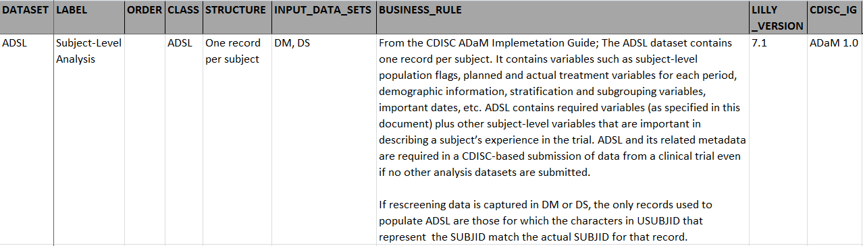
ADSL – Lilly Standard TABLES
Open Lilly ADSL Standard (on SharePoint) TABLES tab
Core_ADAM_ADSL_V7.xlsx
Notes:
Take time here to review the Lilly Standard TABLES tab

Slide 27
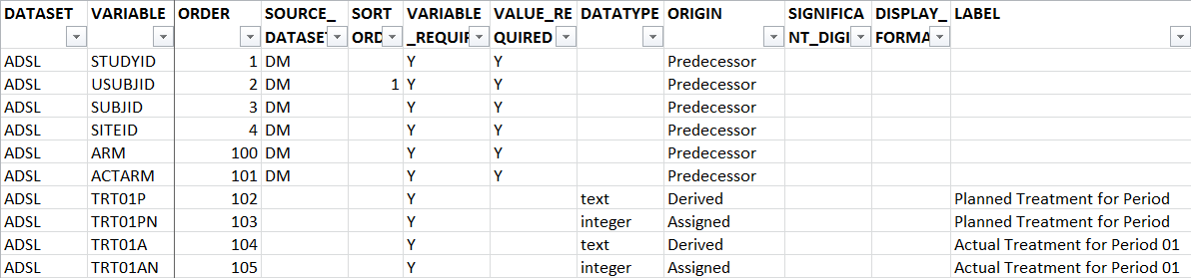
ADSL – Lilly Standard COLUMNS
Open Lilly ADSL Standard (on SharePoint) COLUMNS tab
Core_ADAM_ADSL_V7.xlsx
Notes:
Take time here to review the Lilly Standard COLUMNS tab

Slide 28
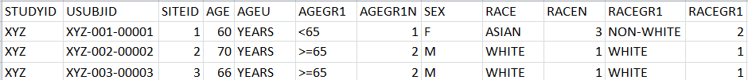
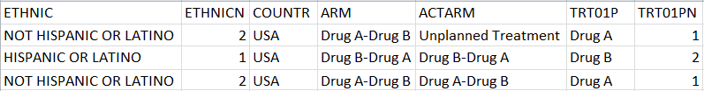
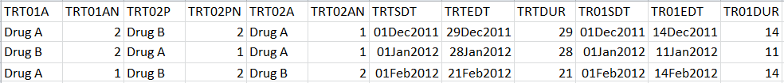
ADSL – Lilly Standard EXAMPLE
Notes:
Take time here to review the Lilly Standard EXAMPLE tab

Slide 29
Lilly Module 3 Exercise #1

Slide 30
Lilly Mod 3 Exercise #1
Open Lilly ADaM Mod 3 Exercise.xlsx
(Q1) What are the ADSL “Required” variables
According to the ADaMIG”?
Consider at least 5 Conditionally Required variables
According to the Lilly ADSL Standard?
Why do these differ?
(Q2) Name the “types of variables” that go into ADSL
According to the ADaMIG”?
According to the Lilly ADSL Standard?
Why do these differ?
Notes:
Q = Question

Slide 31
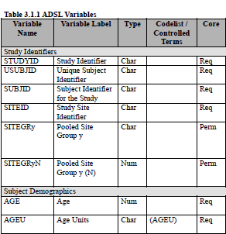
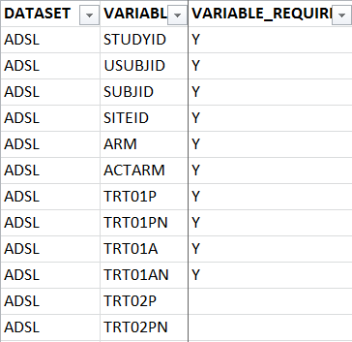
Exercise #1 Getting Started (Q1)
Open ADaMIG v1.0
Open Lilly ADSL Standard

Slide 32
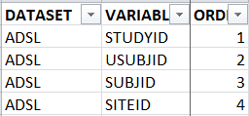
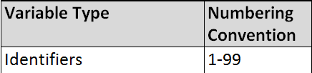
Exercise #1 Getting Started (Q2)
Name 6 Variable Types
Refer to ADaM_ Variable_Numbering_ V2.docx
Check ORDER in Lilly ADSL Standard
Notes:
Need additional instructions on what the documents are that they will need for the exercises and where documents are on the ADaM workshop site

Slide 33
Exercise #1 Q1 Answer
ADaM IG Required Variables:
ADaMIG ADSL Required Variables
STUDYID
USUBJID
SUBJID
SITEID
AGE
AGEU
SEX
RACE
ARM
TRT01P

Slide 34
Exercise #1 Q1 Answer
Examples of ADaM IG Conditionally Required Variables:
5 Examples of ADaMIG ADSL Conditionally Required Variables
At least 1 population flag
TRT01A
TRTSEQP
TRTSDT
TRTEDT
…others ?

Slide 35
Exercise #1 Q1 Answer
Lilly Required ADSL Variables:
Lilly ADSL Standard Required Variables
STUDYID | TRTSDT | TR02SDTM
USUBJID | TRTSDTM | TR02EDTM
SUBJID | TRTEDT | SAFFL
SITEID | TRTEDTM | AGE
ARM | TRTDURN | AGEU
ACTARM | TRTDURU | SEX
TRT01P | TR01SDT | RACE
TRT01PN | TR01SDTM | RACEN
TRT01A | TR01EDT | ETHNIC
TRT01AN | TR01EDTM | ETHNICN
INCNDT |  | COUNTRY

Slide 36
Exercise #1 Q2 Answer
ADaM IG ADSL Variable Types
ADaMIG ADSL Variable Types
ADSL Subject Identifiers
ADSL Subject Demographics
ADSL Population Indicators
ADSL Treatment Variables
ADSL Dose Variables
ADSL Treatment Timing Variables
Subject Level Period, Subperiod, and Phase Timing Variables
ADSL Subject Trial Experience Variables

Slide 37
Exercise #1 Q2 Answer
Lilly ADSL Standard Variable Types
Lilly ADSL Standard Variable Types | Lilly Numbering
Identifiers | 01-99
Treatment Description Variables | 100-199
Trial Dates / Times | 200-299
Population Indicators | 300-399
Demographic and Grouping Variables | 400-499
Other (Study Needed) Variables | 800-899

Slide 38
Treatment Period and Analysis Period

Slide 39
Concept of Treatment Periods
Investigational trials are designed to expose subjects to one or more treatments in one or more defined periods of time
Simplest Case – 1 treatment period:
Dates for the start and stop of each ‘box’ are collected and are used to characterize subject trial disposition
Screening
Double Blind Treatment
Follow Up

Slide 40
ADSL and 1 Treatment Period
USUBJID | ARM | TRT01P | TRT01SDT | TRT01EDT | TR01PGR1
123-1001 | LY XYZ 5mg | Lilly Drug 5 mg | 05Jan2015 | 10Jan2015 | Active
123-1002 | Placebo 5 mg | Placebo 5 mg | 08Feb2015 | 15Aug2015 | Placebo
123-1003 | LY XYZ 10 mg | Lilly Drug 10 mg | 14Feb2015 | 27Aug2015 | Active
123-1004 | LY XYZ 5 mg | Lilly Drug 5 mg |  |  | Active
123-1005 | Placebo 10 mg | Placebo 10 mg | 15Mar2015 | 20Jun2015 | Placebo
123-1006 | SCRNFAIL
Text of ARM and TRT01P do not have to match but meaning should be the same
This subject was randomized but never took any dose
Screen failure data would not typically be included in ADSL
This optional variable is added to create grouping of all active and all placebo
Notes:
Remind them where ARM comes from

Slide 41
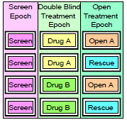
Trial Design with 2 Treatment Periods
TRT01P
TRT02P
TRTSEQP=Drug A – Drug A
TRTSEQP=Drug A – Rescue
TRTSEQP=Drug B – Drug A
TRTSEQP=Drug B – Rescue
In this example, treatment periods may align with same dates used
for analysis periods as well as dates used for Epochs

Slide 42
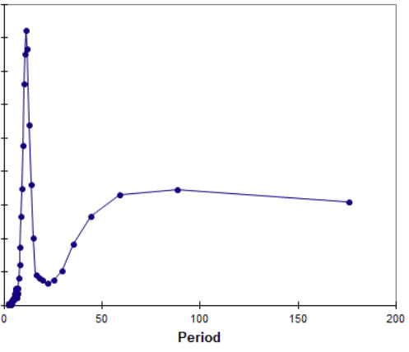
Concept of Analysis Period
When we analyze trial data, we define periods of time to associate the results with a treatment
Period does not have to be defined by the dates a subject was actually exposed to study drug
Example: analyze all adverse events that occur between date of first dose and (date of last dose + ½ life of drug)

Slide 43

Treatment Period
Treatment Period: Defines period of time a subject is actively taking drug
Variables TRTxxP, TRxxSDT, TRxxEDT, etc.

Slide 44
Analysis Period
Analysis Period: Defines period of time that we associate any clinical results with a given treatment
Variables APERIOD, APxxSDT, APxxEDT, etc.
For every analysis period defined, there must be a corresponding treatment period
For example: Cannot define APERIOD=3 if you don’t also define TRT03P
TRT03P | APERIOD | AP03SDT | AP03EDT
Placebo | 3 | 05AUG2015 | 10AUG2015
Drug A | 3 | 08AUG2015 | 14AUG2015

Slide 45
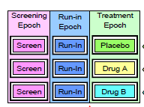
Treatment Period and Analysis Period
Treatment Period
for TRT01P
APERIOD=01
Analysis Period may include data from last observation in Run-in to use for baseline and extend past end of treatment period

Slide 46
Analysis Phase
Analysis Phase: Defines period of time that generally encompasses one or more analysis periods. In this sense it is a “higher” level than analysis period
This concept is most often used to group records that all occurred during a protocol specified period of time
For example:
Screening Phase
Treatment Phase
May contain multiple values of APERIOD
Follow up Phase

Slide 47
Trials Design Variables in ADaM
For a given protocol, determining the number of treatment periods, the values of treatment variables, the number of analysis periods, and the start / stop dates of these concepts is highly dependent on the trial design and the planned analysis
Looking at the protocol schema can be a first step towards understanding how to express the trial design in terms of ADaM variables
Reviewing the TFL shells and SAP to see how data is summarized is also an important step
Begin with the end in mind

Slide 48
Lilly Module 3 Exercise #2

Slide 49
Lilly Mod 3 Exercise #2
Divide class into groups
Each group has a picture of a protocol schema from a Lilly protocol (hard copy hand out)
Each team to determine the following:
How many treatment periods are present?
Provide possible values of TRTxxP for every treatment period
How many analysis periods are present?
If used, what would be possible values of APHASE?
Discuss how the start / stop dates of the treatment period(s) might differ from the start/stop dates of the analysis period(s)?

Slide 50
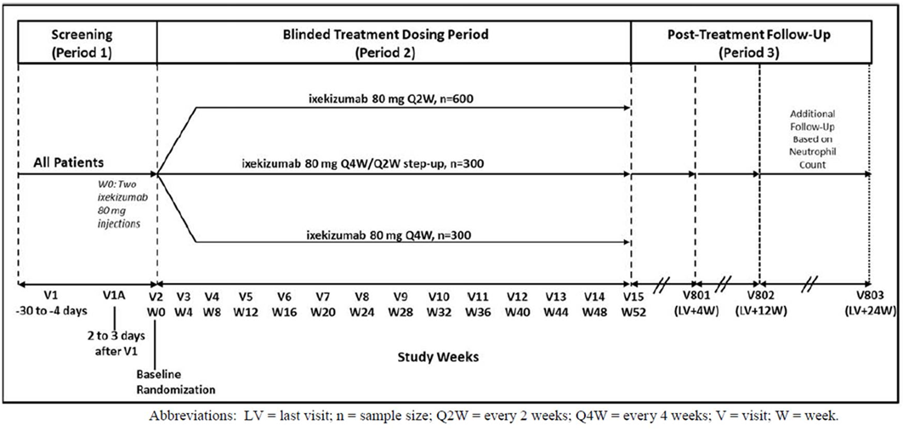
Lilly Protocol Schema #1

Slide 51
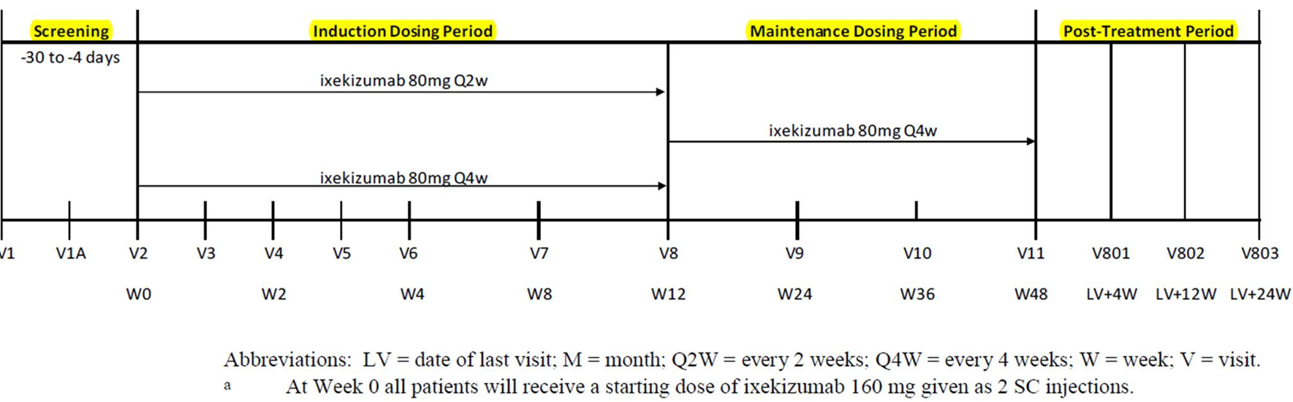
Lilly Protocol Schema #2

Slide 52
Exercise #2 Answer Lilly Protocol Schema #1
Questions | Answer
How many treatment periods are there in this study? | One
For every treatment period, provide suggested values of TRTxxP | TRT01P: ixekizumab 80 mg Q2W ixekizumab 80 mg Q4W/Q2W ixekizumab 80 mg Q4W
How many analysis periods are there in this study? | There can only be one since there is just one treatment period
How might the start / stop dates of the treatment period(s) differ from the start/stop dates of the analysis period(s)? | The treatment period ends at W52 but the analysis period very likely extends into the post-treatment followup phase which lasts an additional 24W.
If used, what values of APHASE could be used for this study? | Screening phase, Blinded Treatment Phase, Post-Treatment Follow-up

Slide 53
Exercise #2 Answer Lilly Protocol Schema # 2
Questions | Answer
How many treatment periods are there in this study? | Two
For every treatment period, provide suggested values of TRTxxP | TRT01P: Ixekizumab 80 mg Q2W Ixekizumab 80 mg Q4W TRT02P: Ixekizumab 80 mg Q4W
How many analysis periods are there in this study? | Probably 2 since the Q2W group transitions to Q4W but would need to look at SAP and table shells. It will depend on whether maintenance period is analyzed separately

Slide 54
Exercise #2 Answer Lilly Protocol Schema # 2
Questions | Answer
How might the start / stop dates of the treatment period(s) differ from the start/stop dates of the analysis period(s)? | For the Q4W treatment group, there is no change in treatment when they enter Maintenance so it would be important to look at SAP and TFL’s to determine how the data for this treatment group is analyzed. If there are tables summarizing the maintenance period for both treatment groups, then having defined analysis periods for both treatment groups would be necessary. It is likely the start date of 2nd analysis period will be the same as the stop date of TRT01P
If used, what values of APHASE could be used for this study? | Screening phase, Treatment, Post Treatment

Slide 55
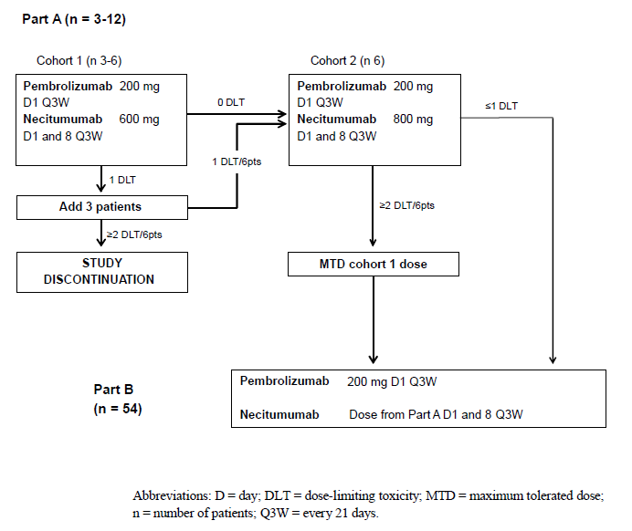
Group Discussion

Slide 56
Group Discussion
How many treatment groups are there in this protocol?
Are there any study-level variables that might be useful to add to ADSL?

Slide 57
Module 3 Summary
ADaM defines 4 classes of ADaM datasets
The ADaM has required, conditionally required, and permissible variables
There are many variable and variable name fragments that are provided in the ADaM IG
ADSL is a required dataset and is of primary importance for every trial.
Understanding the concepts of treatment period and analysis period is fundamental to understanding ADaM implementation

Slide 58
End of Lilly Module 3 ☺

